Slide 1
Abnormalities of Cardiac Conduction
This material has been compiled by many authors & text material.
This is not the sole work of the presenter.

Slide 2
Objectives
Review the cardiac conduction system, including cardiac action potential
Review EKG/ECG
Identify and discuss cardiac conduction disturbances
Discuss treatments for cardiac disturbances
Medications
Technology
Indentify and discuss anesthesia interventions

Slide 3
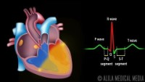
Cardiac Conduction

Slide 4
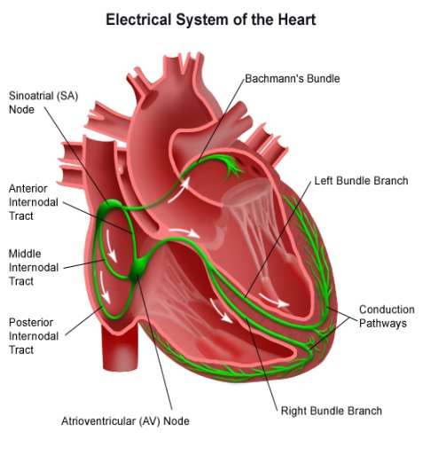
Cardiac Conduction System
Spontaneous depolarization
Electrical impulse moves along conduction system
Wave of depolarization is propagated
SA node is the primary site for impulse conduction
Pacemaker
Discharges at a rate of 60-100 beats/min
AV node (septal wall of the RA)
AV & SA node are innervated by both the sympathetic and parasympathetic nerves
Slows the conduction velocity allowing time for atrial contraction
(atrial kick) (20-25% of cardiac output)
Blood supply primarily from R Coronary Artery (85-90%)

Slide 5
EKG
We usually monitor for 5 or 3 lead EKG to monitor heart rate, rhythm, and ST segment trends
What are the most common leads used in the operating room to monitor heart rhythms?
Which arteries do they correspond to?

Slide 6
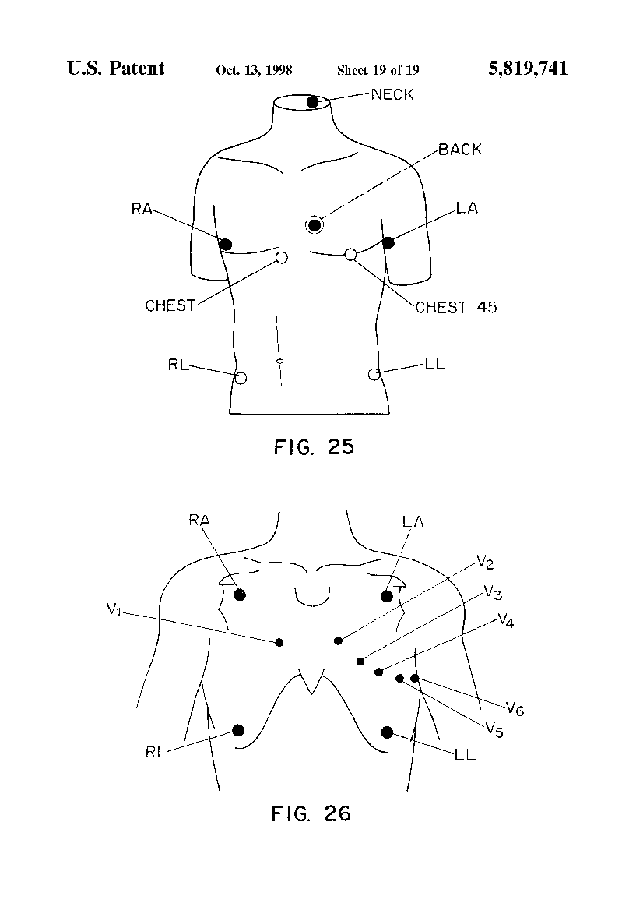
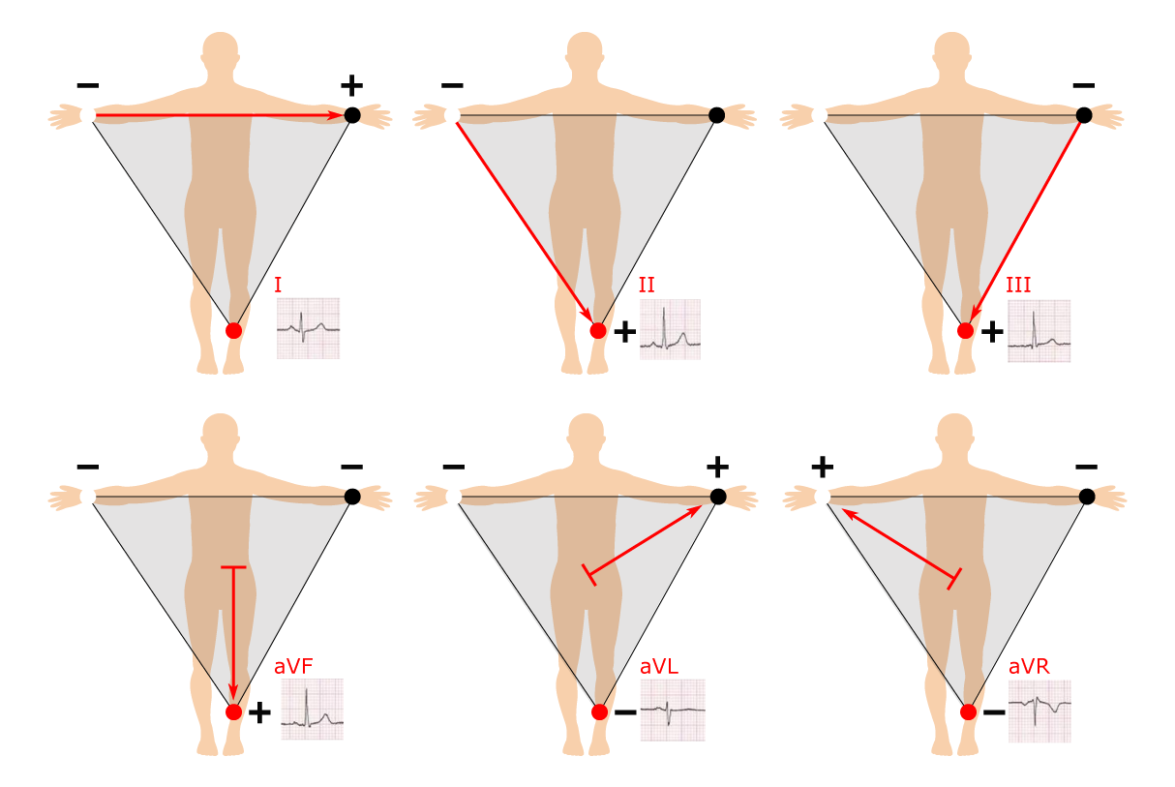
ECG Leads

Slide 7
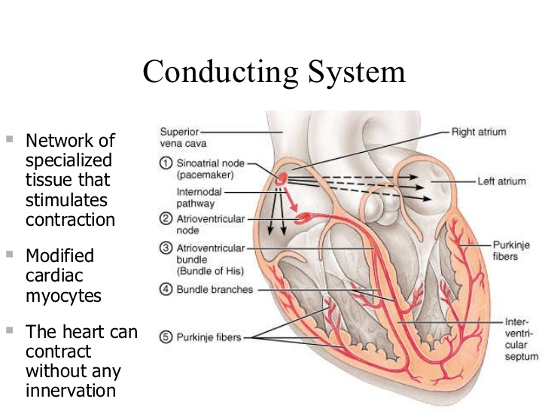
Conducting System

Slide 8
Nodal Firing Rates
SA node = 60 to 100 bpm
AV node = 40 to 60 bpm
AV bundle = 30 to 45 bpm
Purkinje fibers = 30 to 45 bpm

Slide 9
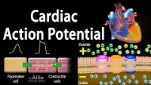
Cardiac Action Potential

Slide 10
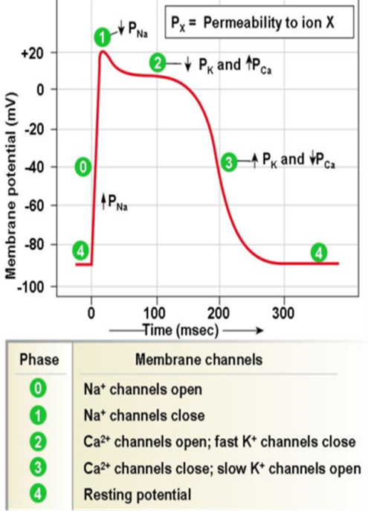
Cardiac Conduction
Electrophysiology of the Conduction System
CV cells-resting membrane potential of -90 mV
Membrane potential increases (Na+ and Ca++ channels open) in response cell membrane charge shifts in neighboring cells → membrane potential ↑+20 mV →initiating action potential

Slide 11
What you need to know:
Depolarization
Repolarization
Resting membrane potential

Slide 12
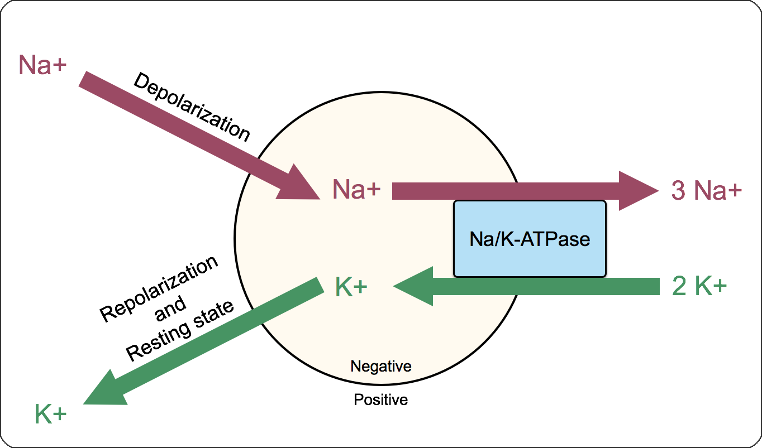
Sodium-Potassium ATPase Pump

Slide 13
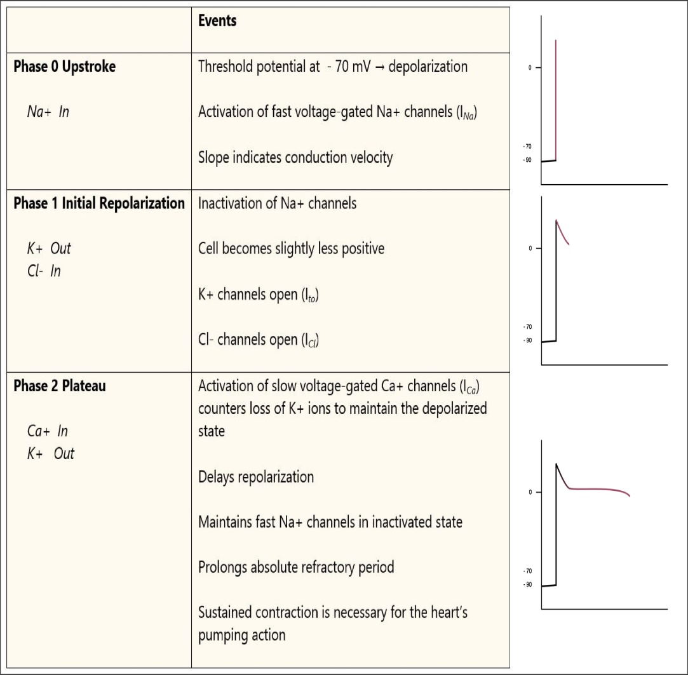
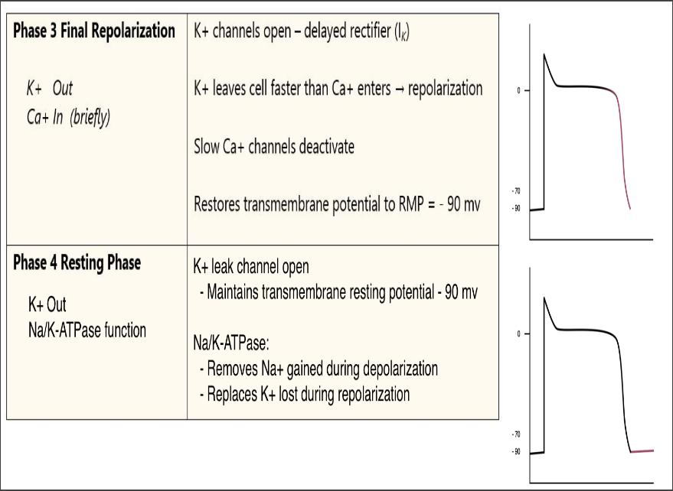
Phases
Phase 0= Depolarization (Na+ in )
Phase1= Initial repolarization (Cl- in and K+ out)
Phase 2= Plateau (Ca2+ in and K+ out)
Phase 3= Repolarization (K+ out)
Phase 4= Maintenance of membrane potential (K + out and Na/Atpase function)

Slide 14
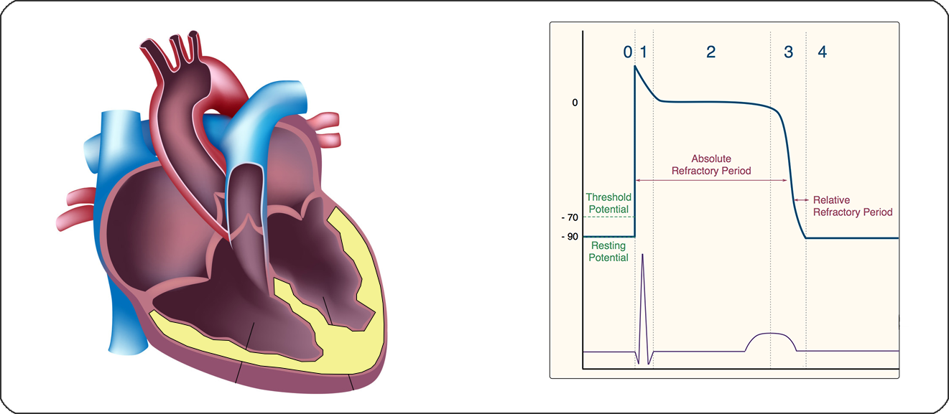
Refractory Period

Slide 15
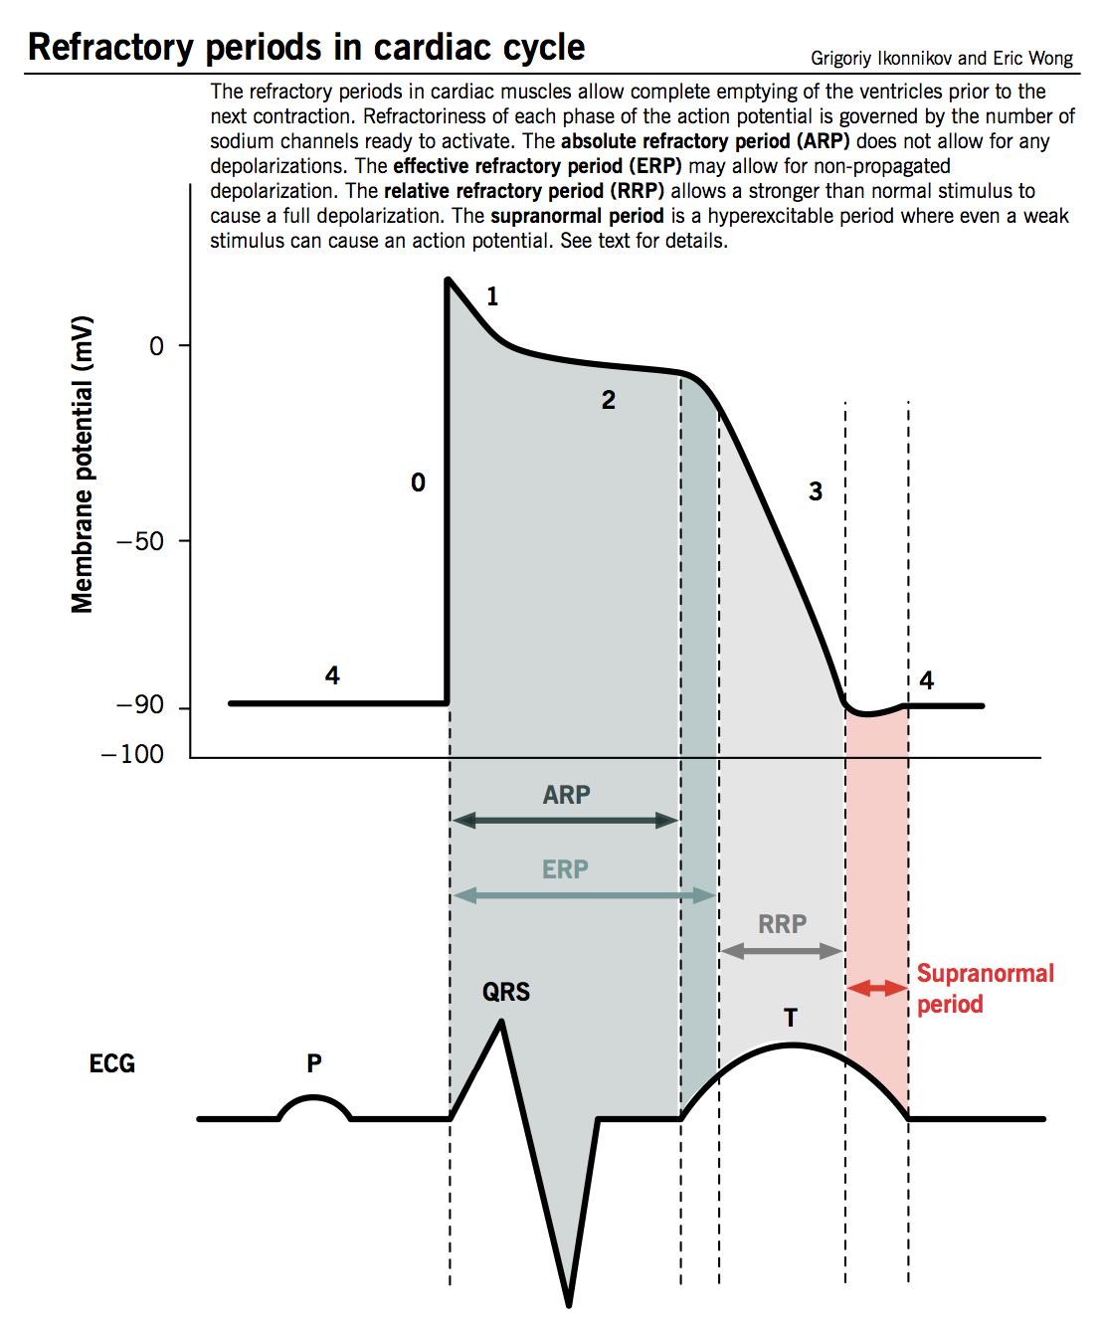
Refractory Period

Slide 16
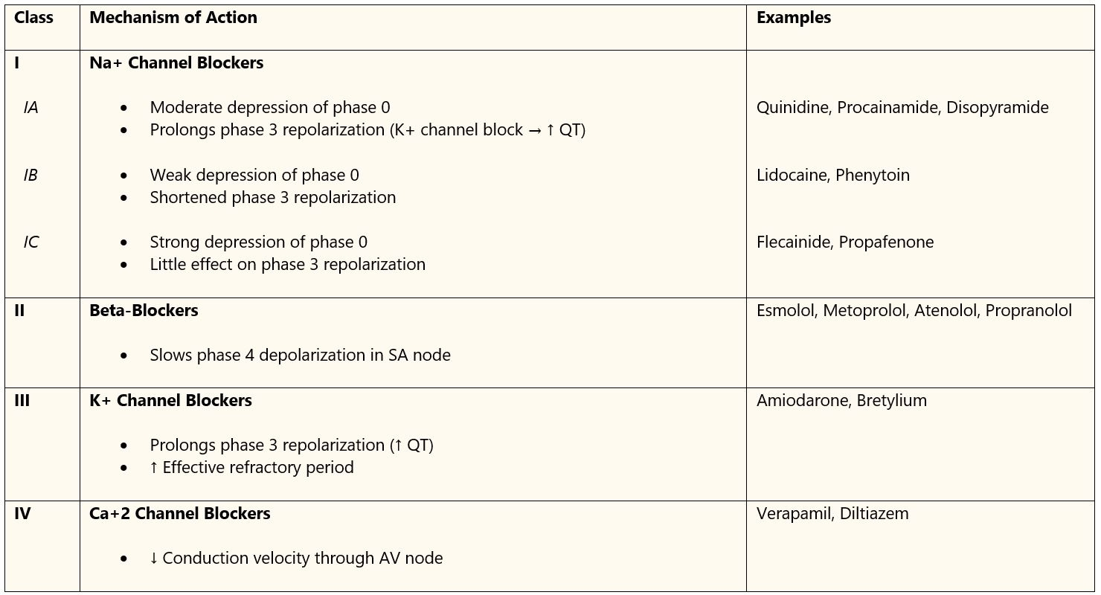
SOBEPOCA – “South Beach Polka”

Slide 17
Cardiac Dysrhythmias
Classified according to:
Heart Rate
Site of abnormality
Can result from:
Increased automaticity
in normal conduction tissue
in an ectopic focus
Reentry of electrical potentials
via abnormal pathways
Triggering of abnormal cardiac potentials
due to after depolarizations

Slide 18
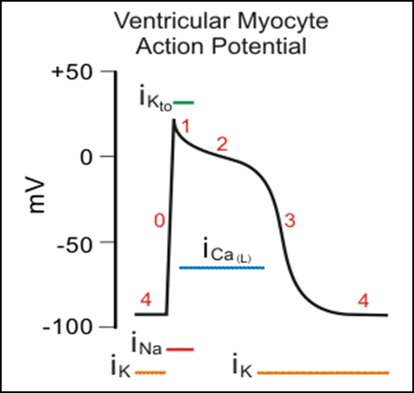
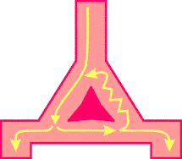
Mechanisms of Tachydysrhythmias
Automaticity
Fastest pacemaker - SA
Automaticity changes when:
slope of phase 4 depolarization shifts
when changes in resting potential
Reentry Pathways
Can have an abrupt onset
requires 2 pathways-conduct at different velocities
accessory tracts (bypass AV node) to stimulate SA
Triggering by afterdepolarizations
Oscillations in the membrane potential that occurs during or after depolarization
Can be triggered by slow HR (tx by ↑ing HR)

Slide 19
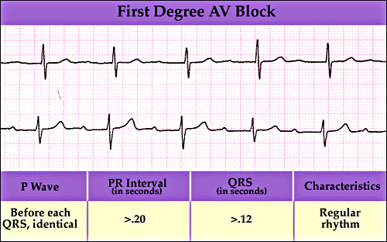
First degree AV block
See text for S/S
Can occur in people without heart disease
could be d/t ↑ vagal tone, digitalis toxicity, inferior wall MI & myocarditis
Anesthetic management
Avoid increasing vagal tone
Assess digoxin levels
Careful use of spinal & epidural anesthesia
Not contraindicated but needs considerations

Slide 20
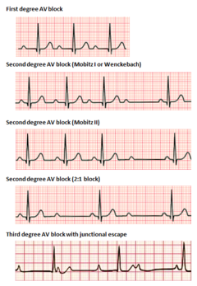
Second Degree Heart Blocks
Two types
Mobitz Type I (Wenckebach)
Progressive prolongation until beat is dropped (P-R prolonged)
Mobitz Type II
No progressive prolongation (P-R is constant)
More indicative of serious cardiac conduction
Anesthetic management
Type I: tx depends on ventricular HR
Type II: higher incidence of V-fib or 3rd degree block
cardiac pacemaker

Slide 21
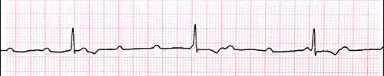
3rd Degree Heart Block
Complete interruption of AV conduction
S/S: syncope, vertigo etc
Tx: transcutaneous or transvenous PM
PM in place prior to induction of anesthesia
Isoproterenol: to maintain acceptable heart rate
Careful administration of antidysrhythmic drugs
May suppress the ectopic pacemakers that are responsible for maintaining heart rate

Slide 22
Intraventricular Conduction Disturbances
The Right Bundle Branch (RBB)
Relatively thin bundle of fibers along RV
doesn’t branch until the RV apex
Late branching that makes it more vulnerable to interruption
The Left Bundle Branch (LBB)
Divides into 2 fascicles
L anterior & Posterior fascicles
Branches earlier & widely
LBBB more serious than RBBB (more indicative of serious cardiac damage)
RBB & LBB distal branches interlace to form Purkinje fibers

Slide 23
Bundle Branch Blocks (BBBs)
Conduction disturbances at various levels of the His-Purkinge system
Two types:
Right Bundle Branch Block (RBBB)
Left Bundle Branch Block (LBBB)

Slide 24
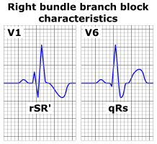
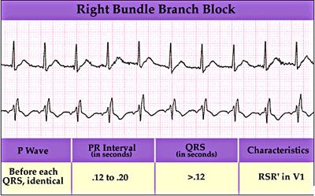
RBBB
RBBB more common than LBBB in patients without structural heart disease
Widened QRS complex and an rSR’ in V1 & V2
Anesthetic Management
Avoid hypotension, hypoxemia, alterations in electrolytes (disturbances can result in 3rd degree Heart Block)
General & Regional Anesthesia can be used
Prophylactic cardiac pacemaker not required
Continuous EKG monitoring

Slide 25
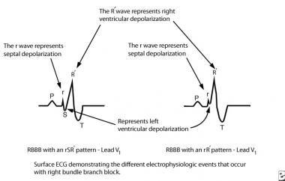
rSR

Slide 26
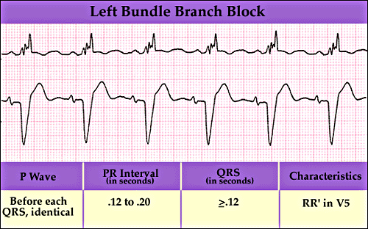
LBBB
LBBB can be chronic or intermittent
Often a marker for serious heart disease, hypertension, CAD, Aortic valve disease and cardiomyopathy
Anesthesia Management
Same as for RBBB
Special attention must be made for insertion of an intracardiac catheter
Can induce RBBB

Slide 27
Artificial Cardiac Pacemakers
Transcutaneous Cardiac Pacing
Place chest & back electrodes over areas of lesser skeletal muscle mass
Low density constant currents should be delivered
Temporizing measure
Permanently implanted cardiac pacemakers
Most common indication → sick sinus syndrome
Only long term treatment for symptomatic bradycardia
Pacing Modes

Slide 28
Pacing Modes
5 letter generic code describes characteristics of pacemakers
1st letter denotes chamber(s) being paced
2nd letter denotes chamber (s) that detects the electrical signals
3rd letter indicates the response to the sensed signals
4th letter “R” denotes activation of rate response features
5th letter denotes the chamber(s) in which multisite pacing is delivered
The most common are AAI, VVI and DDD
Sensing: (A (atrial); V (Ventricular); D (dual chamber)
Response: (I= inhibition; T= triggering; D = dual (inhibition & triggering)

Slide 29
Pacemakers
DDD Pacing
The atrial output is inhibited if an intrinsic atrial signal is sensed, and, if no ventricular activity is sensed by the end of the programmed AV interval, ventricular output is activated. If intrinsic ventricular activity is sensed the ventricular activity is inhibited. Dual chamber pacemakers maintain synchrony between the atria and ventricles
DDD pacing minimizes the incidence of “pacemaker syndrome” – a constellation of symptoms that includes weakness, orthopnea, paroxysmal nocturnal dyspnea, hypotension and pulmonary edema
DDI Pacing
Sensing in both the atria and ventricle but only a response to a sensed event is inhibited
Useful for patients with frequent atrial tachydysrhythmias
Most cardiac pacers can be converted to an asynchronous mode by placing an external magnet over the pulse generator
Conversion may be considered prior to surgery in some patients

Slide 30
Rate Adaptive Pacers
Considered for patients who do not have an appropriate response to exercise
Uses sensors to detect physical or physiologic indices of exercise and mimics the rate response of NSR
Indices include body movement, minute ventilation, QT interval, and stroke volume

Slide 31
Implanted Cardioverter-defibrillator (ICD)
Single most important factor for survival from cardiac arrest from v-fib is time between arrest and fibrillation
ICDs respond to a dysrhythmia by delivering an internal shock within 15 seconds of dysrhythmia
Can be single or dual chamber

Slide 32
Surgery in patients with cardiac devices
Preoperative Evaluation
Determine the reason for the pacemaker or ICD & assess its current function
Coordinate with a cardiologist
ICD’s are often switched off prior to surgery
Pacemakers are usually allowed to continue functioning during surgery
Assess function by evaluation before, during and after surgery
Chest x-ray can determine positioning of the electrodes

Slide 33
Surgery in patients with cardiac devices
Anesthesia Management
Pacemakers
Monitor EKG to confirm proper functioning of pulse generator
Ensure proper equipment and medications are available to initiate ACLS
Intracardiac catheters
do not disturb epicardial electrode function
may become entangled or dislodge transvenous electrodes
Ensure proper shielding of generators from bovie
Grounding electrode - placed as far away as possible from generator
Avoid hyperventilation to ensure normokalemia
Succinylcholine use with caution

Slide 34
Dysrhythmia overview
Dysrhythmias: Cardiac rhythms with abnormalities in rate, interval length, or conduction path
Intraoperative arrythmias occur in approximately 11% of general anesthetics.
Most common intraoperative arrhythmias are sinus tachycardia and sinus bradycardia.
Three basic causes of dysrhythmia in the anesthetized patient:
patient physiology and existing abnormalities
stimulation or iatrogenic factors from the procedure
effects of the anesthetic itself

Slide 35
Mechanisms of tachydysrhythmias
HR >100 bpm initiated from a pacemaker source above or below the bundle of His.
Above the bundle of His are SVTs
usually narrow QRS complex: sinus tachycardia, atrial flutter, atrial fibrillation, junctional tachycardia, paroxysmal atrial tachycardia, and accessory pathway–mediated reentrant tachycardias.
Below the AV node have a wide QRS complex.
ventricular tachycardia, SVT with an intraventricular conduction defect or bundle branch block, SVT with aberrant conduction, SVT with wide QRS due to a metabolic or electrolyte disorder, and SVT with conduction over a preexcitation (accessory) pathway.
Tachydysrhythmias can result from three mechanisms:
increased automaticity in normal conduction tissue or in an ectopic focus
reentry of electrical potentials through abnormal pathways
triggering of abnormal cardiac potentials due to afterdepolarizations

Slide 36
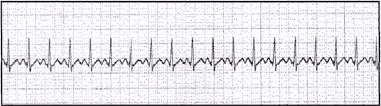
Sinus Tachycardia
Caused by an acceleration thru SA node
HR between 100-150 bpm
most common supraventricular dysrhythmia seen during anesthesia in the operating room.
Most common dysrhythmia associated with acute MI (30-40% incidence)
Treatment
Correct underlying cause
Supplemental oxygen
Avoid vagolytic drugs
Pancuronium, Atropine, Glycopyrrolate
Beta blockade can be used if:
Patient is not hypovolemic, bronchospastic (hx of asthma), or has impaired cardiac function

Slide 37
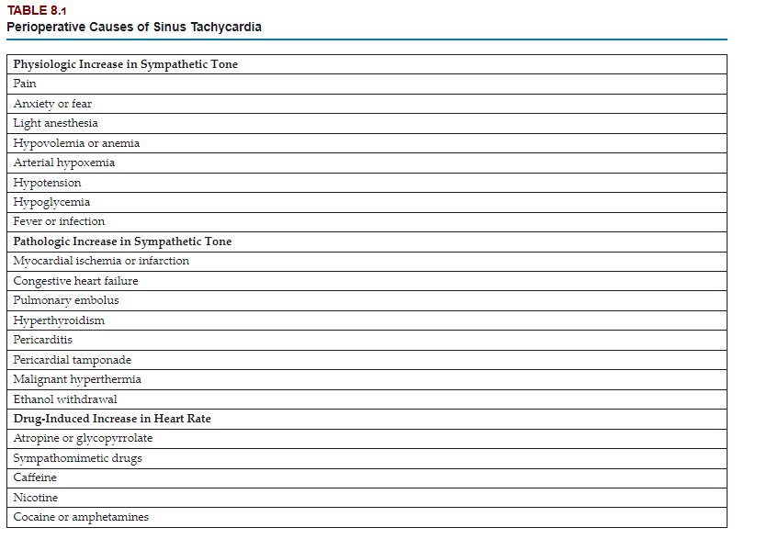

Slide 38
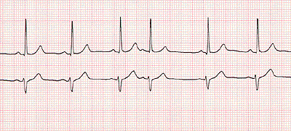
Premature Atrial Beats
From ectopic foci in atria
Most commonly seen in patients with
chronic lung disease
ischemic heart disease
digitalis toxicity
Second most common dysrhythmia associated with acute MI
Management
Avoid excessive sympathetic stimulation
Can be suppressed with beta blockade or calcium channel blockers

Slide 39
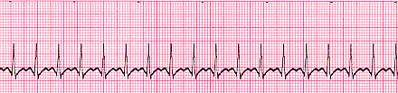
Paroxysmal Supraventricular Tachycardia (PSVT)
SVT is any tachydysrhythmia initiated by tissue at or above the SA node
Average HR 150-250 bpm
Common symptoms include
Lightheadiness, dizziness, fatigue, chest discomfort, dyspnea, syncope (15%)
Management
Avoid factors that provoke SVT:
Increased sympathetic tone, electrolyte imbalances, acid-base disturbances
If stable
Vagal maneuvers
If unstable
AV node blockade
Adenosine
Calcium channel blockers
Beta blockers

Slide 40
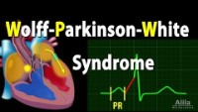
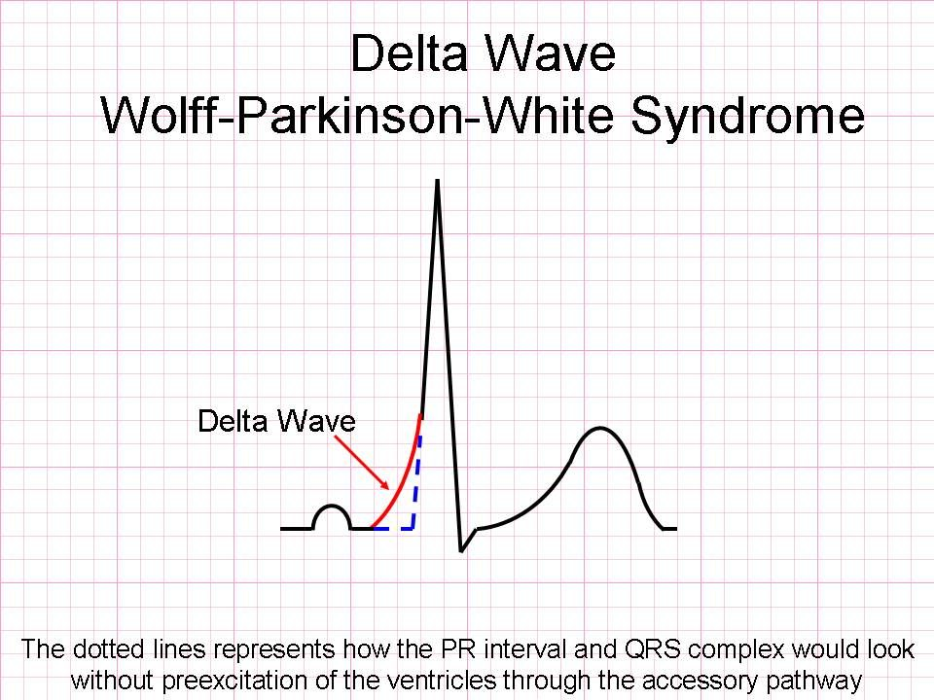
Delta Wave
https://www.youtube.com/watch?v=-dHaaGx1W-g

Slide 41
Wolf-Parkinson-White Syndrome
Tachydysrhythmias begin in early adulthood
Paroxysmal palpitations with/without syncope, dizziness, dyspnea, angina
Most common tachydysrhythmia associated with WPW:
AV nodal re-entry tachycardia (AVNRT)
Usually triggered by a PAC
Ventricular pre-excitation causes earlier deflection of QRS (delta wave)
AVNRT classified as:
Antidromic (wide QRS complex)
Orthodromic (narrow QRS complex)
Orthodromic more common (90-95%) – narrow complex→cardiac impulses conducted from atrium through normal AV node-HIS Perkinje system return to atria through accessory pathways

Slide 42
Wolf-Parkinson-White Syndrome
Anesthetic management
Patients with known WPW presenting for surgery should continue to receive their antidysrhythmic drugs
Procainamide
Avoid events (increased sympathetic nervous system activity due to pain, anxiety or hypovolemia) or drugs (digoxin) that could enhance anterograde conduction of impulses through accessory pathways
Electrical cardioversion, if unstable

Slide 43
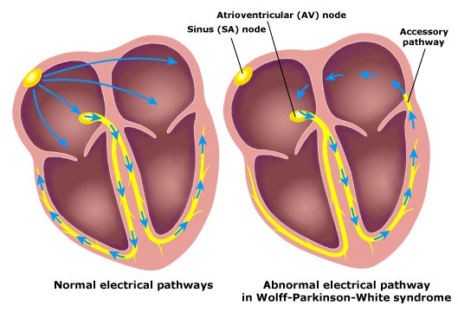
Wolf-Parkinson-White Syndrome

Slide 44
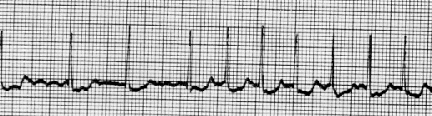
Atrial Fibrillation
Most common sustained cardiac dysrhythmia in the general population
No uniform depolarization or contraction of atria
Predisposing conditions (Rheumatic heart disease, HTN, COPD, ASD etc)
Elective cardioversion most effective
Digoxin can be useful to control ventricular rate but is ineffective in converting A-fib
Management
Postpone surgery if present prior to elective surgery (if new onset)
If chronic a-fib
Maintain on antidysrhythmic drugs
Amiodarone (most frequently prescribed) (prolongs Phase 3)
Propfenone (decreases Phase 0)
Ibutilide (prolongs Phase 3)
Sotalol (prolongs Phase 3)
Monitor preoperative labs
Electrolytes (esp. Ca++, K+, Mg+)
Coagulation profile
Frequently patients maintained on oral anticoagulation meds preoperatively
Carefully monitor patients for adverse events from anticoagulation discontinuance

Slide 45
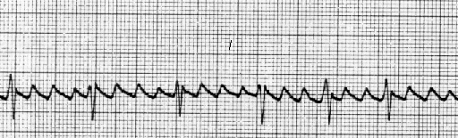
Atrial Flutter
Atrial contraction rate between 250-350 bpm
Most present with 2:1 AV conduction
Which means a ventricular rate of ≈ 180 bpm
Characterized by flutter waves
Usually associated with structural heart disease
Treated with cardioversion (usually covert < 50 j)
Management
If present before induction in elective cases they should be cancelled and treated by cardiology
If occurrence during anesthesia, treat based on hemodynamic stability
Cardioversion (< 50 j)
Pharmacological management (based on co-existing diseases present)
Adenosine
Amiodarone
Diltiazam
Verapamil

Slide 46

Premature Ventricular Contractions (PVCs)
Ventricular contraction occurs without accompanying atrial contraction
Volume of blood smaller than normal
See compensatory pause larger than norm
Typically benign in most individual if isolated
Unifocal or multifocal
Bigeminy vs Trigeminy
Management
Treat for > 6 PVCs/minute and repetitive or if multifocal
Treat underlying cause
Acidosis, Electrolyte disturbances, Prodysrhythmic drugs, or mechanical stimulation (from intracardiac catheters)
Beta blockers, Lidocaine, Amiodarone

Slide 47
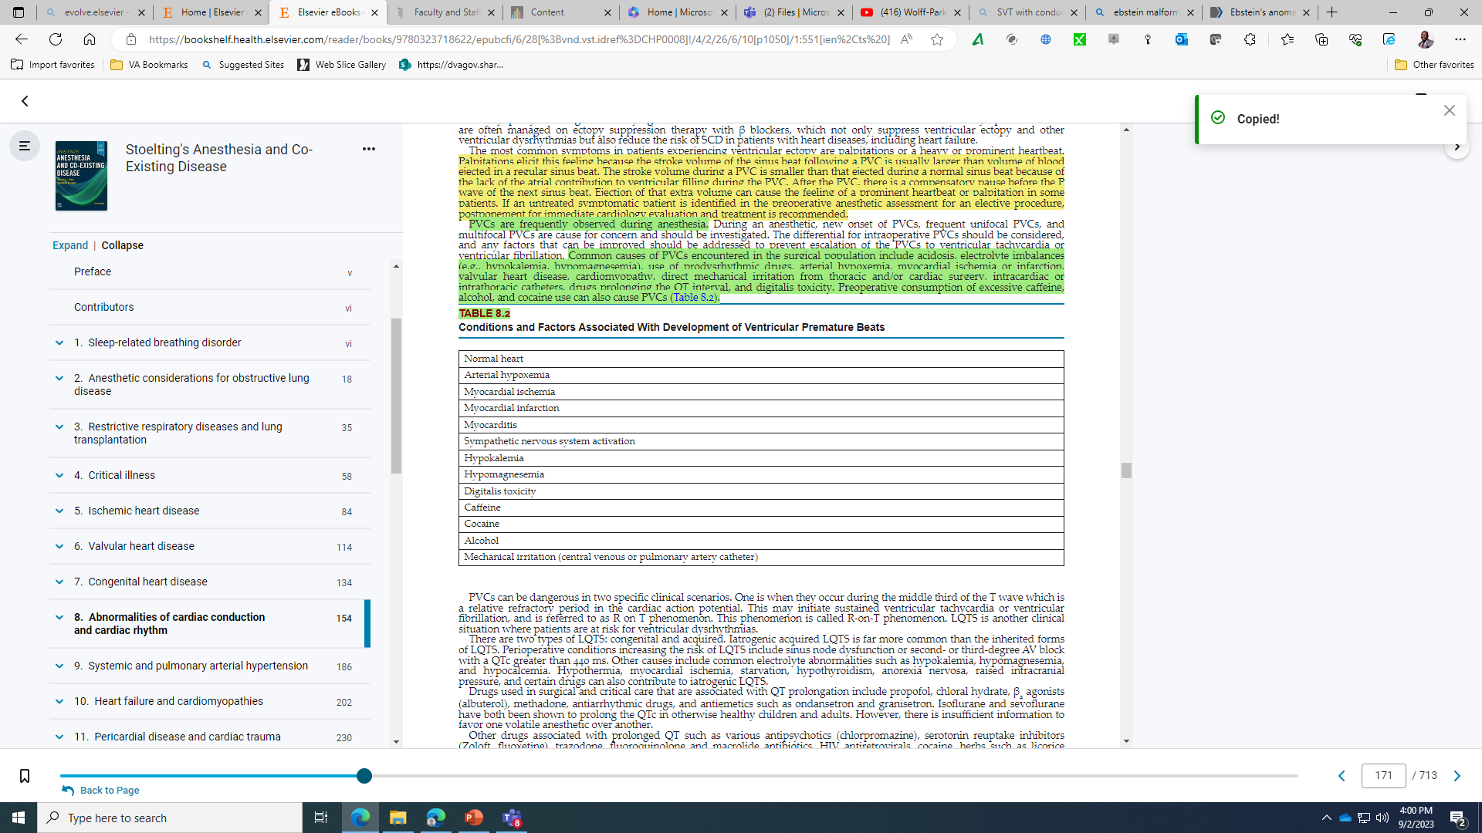

Slide 48
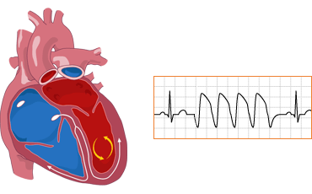
Ventricular Tachycardia
V-tach present when 3+ PVCs occur at a calculated HR of > 100 bpm lasting >30 seconds
Sustained ventricular tachycardia: regular rhythm of 100 to 200 bpm
The ratio of P waves to QRS has no fixed relationship because there is atrioventricular dissociation.
Management
If during anesthesia → immediate investigation into possible causes before it becomes sustained
Treat using conventional anti-dysrhythmic meds
Lidocaine bolus 2 mg/kg
Infusion postoperatively

Slide 49
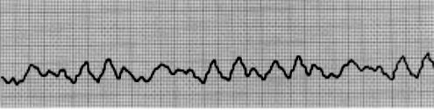
Ventricular Fibrillation
Irregular ventricular rhythm incompatible with life
Electrical defibrillation is the only effective method to convert v-fib
Instituted ASAP (within 3-5 minutes)
Epinephrine 1 mg IV
Vasopressin 40u IV may improve response to defibrillation
Anesthetic management
Initiate CPR
ACLS Protocol

Slide 50
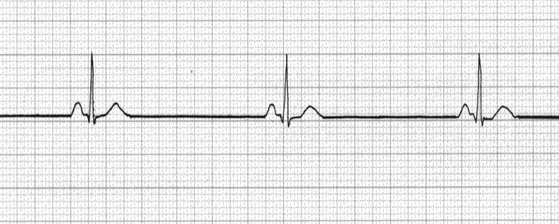
Sinus Bradycardia
HR < 60 bpm → ↓normal discharge rate of SA node
Asymptomatic patients = no treatment required
Atropine 1 mg IV every 3-5 minutes (up to a maximum of 3 mg)
Inappropriate sinus bradycardia (associated with degenerative changes in SA node) = Sick Sinus Syndrome (SSS)
Anesthetic Management
Can be associated with spinal and epidural anesthesia
Assess level of block
Probably caused from sympathectomy (↓ venous return →vagal response)
Treat with vagolytic medications
Monitor asymptomatic patients for worsening of symptoms
Symptomatic tx:
Atropine
Glycopyrrolate
If severe:
Immediate transcutaneous pacing

Slide 51
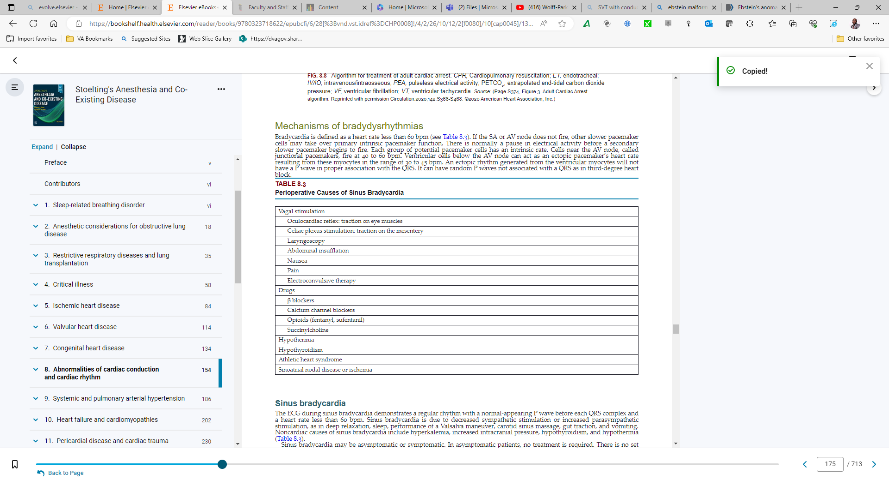

Slide 52
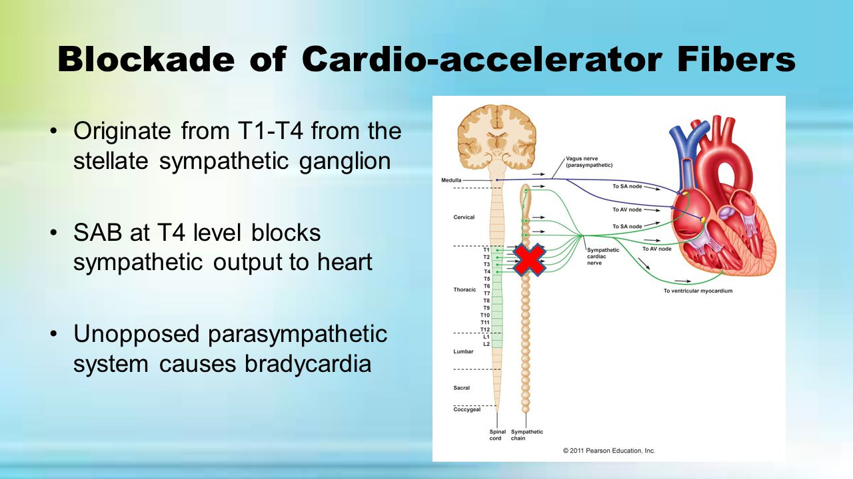
Sinus Bradycardia During Regional Anesthetics
Bezold-Jarisch response
Unopposed parasympathetic nervous system activity
Blockade of cardiac accelerator fibers (T1-T4)

Slide 53
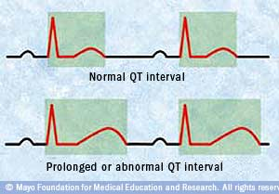
Prolonged QT Syndrome
Two types of prolonged (long) QT Syndrome (LQTS)
Congenital & Acquired
Syncope is the hallmark sign of LQTS (Sudden death syndrome)
Treatment of LQTS: correct electrolyte abnormalities (Mg+ and K+)
Acquired LQTS may be caused from:
Antibiotics, Antidysrhythmic drugs, Antidepressants
Antiemetics- ondansetron, droperidol etc.
“Diet pills”

Slide 54
Prolonged QT Syndrome
Anesthetic Management
Preoperative EKG if patient has a history (or family history) of LQTS
Isoflurane & Sevoflurane have been shown to prolong QTc
TIVA may be best choice
Inconclusive evidence regarding Desflurane
Droperiodol, ondansetron (most antiemetics) can prolong QTc
Avoid abrupt increases in sympathetic activity
Pain, hypovolemia etc
Ensure adequate electrolyte balance
Consider beta blockade prior to induction and laryngoscopy
Defibrillator should be available

Slide 55
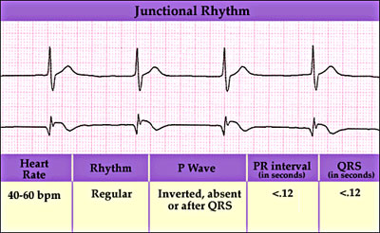
Junctional Rhythm
See text for S/S
Due to activity of a cardiac pacemaker in the tissues surrounding the AV node
Intrinsic rate 40-60 bpm
Transient junctional rhythms require no treatment
Anesthetic management
Not infrequent during GA with halogenated agents
Loss of atrial kick could be detrimental to some populations
Treat with atropine 1 mg IV for hemodynamically significant junctional rhythms

Slide 56
Medications for treatment of cardiac dysrhythmias
Review these drugs
Adenosine
Amiodarone
Beta blockers
Calcium channel blockers
Digoxin
Lidocaine
Magnesium
Procainamide
Sotalol
Epinephrine
Vasopressin
Atropine
Isoproterenol
Dopamine

Slide 57
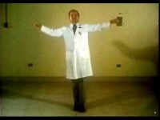
Living Arrhythmias

Slide 58
Case Summary:
You are the anesthesia resident assigned to the case of Mr. Robert Williams, a 72-year-old male scheduled for an elective cholecystectomy due to symptomatic cholelithiasis. Mr. Williams has a history of hypertension, coronary artery disease (CAD), and atrial fibrillation, for which he is maintained on metoprolol, warfarin, and amiodarone. Recently, he was found to have a left bundle branch block (LBBB) on a routine ECG, and his cardiologist has advised close monitoring during any surgical procedure.
Objectives:
Review the cardiac conduction system, including cardiac action potential.
Review EKG/ECG.
Identify and discuss cardiac conduction disturbances.
Discuss treatments for cardiac disturbances.
Identify and discuss anesthesia interventions.

Slide 59
Preoperative Evaluation:
1. Patient History:
Cardiac History: Mr. Williams has a history of CAD, managed hypertension, and chronic atrial fibrillation. His atrial fibrillation has been controlled with amiodarone, and his rate is managed with metoprolol. He was recently diagnosed with LBBB, raising concerns about potential underlying cardiac conditions, particularly in the setting of CAD.
Symptoms: He reports occasional episodes of dizziness and mild shortness of breath, which his cardiologist attributes to his LBBB and underlying heart disease.
2. Physical Examination:
Vital Signs: BP 130/85 mmHg, HR 65 bpm (irregular), RR 16, SpO2 98% on room air.
Cardiovascular Exam: Irregularly irregular rhythm consistent with atrial fibrillation. No murmurs, but a loud S2 is noted, consistent with his LBBB.
3. Preoperative Testing:
ECG: Confirms the presence of a left bundle branch block (LBBB) with a wide QRS complex (>120 ms) and a right axis deviation. Atrial fibrillation is present with an average ventricular rate of 65 bpm.
Echocardiogram: Shows left ventricular hypertrophy with a preserved ejection fraction (55%), and mild left atrial enlargement. No significant valvular disease is noted.
Labs: INR is 2.3, indicating adequate anticoagulation control.
4. Risk Stratification:
Cardiac Risk: Given his history of CAD, LBBB, and atrial fibrillation, Mr. Williams is at high risk for perioperative cardiac complications, including arrhythmias, myocardial ischemia, and heart block.

Slide 60
Discussion Points for Residents:
Cardiac Conduction System and Action Potential:
Q1: Explain the role of the cardiac conduction system, specifically the SA node, AV node, and bundle branches, in maintaining normal cardiac rhythm. How does a left bundle branch block (LBBB) alter normal conduction?
Q2: Discuss the phases of the cardiac action potential and how disturbances in these phases can lead to arrhythmias.
EKG/ECG Interpretation:
Q3: What are the key features of LBBB on an ECG? How does LBBB affect the interpretation of ischemia in this patient, particularly in the context of his history of CAD?
Cardiac Conduction Disturbances:
Q4: What are the clinical implications of LBBB in the perioperative setting? How does it affect anesthetic management, particularly regarding monitoring and the potential for progression to complete heart block?
Treatment of Cardiac Disturbances:
Q5: Given Mr. Williams’ atrial fibrillation and LBBB, what are the most appropriate treatment options for managing his arrhythmias perioperatively? Discuss the role of medications such as amiodarone and beta-blockers in this setting.
Q6: How would you prepare for the potential need for pacing or other advanced cardiac interventions during surgery?
Anesthesia Interventions:
Q7: What are the key anesthetic considerations for Mr. Williams, given his LBBB and atrial fibrillation? How would you adjust your anesthetic plan to minimize the risk of exacerbating his conduction disturbances?

Slide 61
Intraoperative Management:
Induction: Mr. Williams is induced with etomidate, fentanyl, and rocuronium to minimize hemodynamic fluctuations. Given his history of LBBB, special care is taken to avoid significant drops in blood pressure that could precipitate ischemia or worsen conduction disturbances.
Maintenance: Anesthesia is maintained with a combination of sevoflurane and remifentanil. Continuous ECG monitoring is employed, with special attention to the QRS duration and any new changes that might indicate ischemia or progression to complete heart block. An external pacemaker is immediately available should it be needed.
Intraoperative Events: Midway through the procedure, Mr. Williams develops bradycardia with a heart rate dropping to 45 bpm. The anesthetic team administers a small dose of atropine (0.5 mg) to increase the heart rate. The patient's heart rate responds appropriately, increasing to 65 bpm. Continuous monitoring is maintained to ensure no progression to complete heart block.
Later in the procedure, the patient experiences a drop in blood pressure (BP 85/50 mmHg). Phenylephrine is administered to increase SVR and maintain coronary perfusion, with a gradual improvement in blood pressure back to baseline levels.

Slide 62
Postoperative Management:
Recovery: Mr. Williams is extubated in the operating room and transferred to the PACU for continued monitoring. His ECG remains stable, with persistent LBBB but no signs of ischemia. Postoperative pain is managed with intravenous acetaminophen and low-dose morphine, titrated carefully to avoid respiratory depression.
Discussion Points:
Q8: What are the key postoperative concerns for Mr. Williams, particularly regarding his LBBB and risk for arrhythmias? How would you manage these concerns in the PACU?
Q9: How would you monitor for and manage potential complications such as bradycardia or heart block postoperatively?

Slide 63
Conclusion:
This case study provides an opportunity to explore the complexities of managing a patient with abnormalities of cardiac conduction, specifically LBBB and atrial fibrillation, in the perioperative setting. It emphasizes the importance of understanding the cardiac conduction system, ECG interpretation, and the careful selection of anesthetic and pharmacologic interventions to minimize the risk of exacerbating conduction disturbances.

